Slide 1
Inpatient Survey 2019: Trust webinar

Slide 2
Agenda
Survey overview
What’s new for 2019?
Methodological changes
Questionnaire changes
Covering letter changes
Section 251 requirements
Practicalities of administration
Sampling and submission process
Fieldwork monitoring information
Key dates
Contact

Slide 3
Survey Overview

Slide 4
Sampling
Sample is a consecutive discharge sample
Maximum sample size is 1,250 patients
Trusts submit a combined sample and mailing file to their approved contractor
IH trusts submit sample file only to Survey Coordination Centre
Full details provided in the sampling instructions

Slide 5
Survey Materials
12 page colour questionnaire (postal): 82 quant questions and free text comment box
Colour covering letters
3 mailings:
Mailing | Contents | Timing of mailing
M1 (first mailing) | Covering letter, paper questionnaire, Multilanguage sheet, freepost return envelope | After sample approval
M2 (first reminder) | Reminder letter only | 5 working days after M1
M3 (second reminder) | Covering letter, paper questionnaire, Multilanguage sheet, freepost return envelope | 2-3 weeks after M2

Slide 6
Survey Materials
Questionnaire and covering letters to be published following ethics approval (July 2019)
Dissent poster has been redesigned and is available in 10 languages: English and 9 other most commonly spoken languages in England
No CQC flyer

Slide 7
What’s new for 2019?

Slide 8
Methodological changes
Confirmation of contractor
This year we won’t ask trusts to confirm their contractor to us. Instead we’ll ask contractors to send us a list of trusts they’re working with.
ICD-11 codes:
We will include both ICD-10 and ICD-11 codes in the sampling instructions

Slide 9
Questionnaire changes
Minor changes to the questionnaire:
Desk research identifying developments in policy and models of service provision
Analysis of questionnaire performance using 2018 data
Cognitive testing with 18 recent adult inpatients
Resulted in a small number of changes:
Minor changes to existing questions or response options
Coloured routing instructions
Coloured instructions and statements on question items
New question: frailty (added in the About You section: Q77)
Total number of questions= 82 (increased by 1 compared to 2018)
Full details in the survey development report
Questionnaire will be published after ethics approval granted (July 2019)

Slide 10
Covering letter changes
Changes to format and wording in line with work across the NHS Patient Survey Programme:
Clearer wording including reference to ‘overnight’ stay
More information about data protection added
The 1st reminder letter will have the trust header and signatory as per the other two letters
Covering letters will be published after Ethics approval granted.

Slide 11
Other changes
No CQC flyer included in survey packs
This is in line with the practice elsewhere in the programme following a recent pilot suggesting that its inclusion has no beneficial impact on response rates

Slide 12
Section 251 requirements

Slide 13
What is Section 251?
Allows the common law duty of confidentiality to be put aside in order to enable the processing of patient identifiable information without consent.
Provides a legal basis for trusts to provide names and addresses to contractors.
Any deviation from the methodology outlined in the survey instruction manuals may render the approval invalid and CQC will be obliged to take action.

Slide 14
Section 251 requirements
Dissent posters give potential participants the opportunity to opt out of the survey.
With the exception of the trust information box, it is not permitted to alter the poster in any way.
In the box provided, a telephone number must be added. In addition, an email and a postal address should be provided if they are available.
Posters must be on display during the sampling month(s) to comply with S251 requirements:
As a minimum, this is July 2019
Some trusts may have to display in June 2019

Slide 15
Section 251 requirements
We recommend you publicise the survey both internally and externally to ensure patients are aware of the survey and have the opportunity to opt-out should they wish. Example materials are available in the Publicising the survey document.
Ensure a log of patients who have dissented from taking part in the survey is accurately kept.
Ensure the total number of eligible patients who have dissented from the sharing of their details for any purpose other than their clinical care, or who have dissented from taking part in the survey specifically, are recorded in your sample declaration form and are excluded from your sample.
Do not exclude patients under the National Data Guardian opt out: the NPSP has exemption from this

Slide 16
National Data Opt Out Programme - Exemption

Slide 17
Potential Section 251 breaches
Trusts sending sample data directly to the Survey Coordination Centre before the declaration form has been approved
Survey Coordination Centre receiving mailing data.
Trusts submitting sample file via email rather than FTP.
Trusts mentioning patient identifiable information (e.g. DOB) over email.
Trusts not password-protecting files.
Generic document on Data protection and confidentiality available on our website.

Slide 18
Practicalities of administration

Slide 19
Practicalities of administration (in-house trusts only)
Questionnaire must be printed in colour, in booklet format with centre staples.
Covering letters must also be printed in colour, on trust headed paper with trust signatory.
Questionnaire and covering letters to be published following Ethics approval.
PDF and hard copy covering letters and questionnaire to be submitted to us for checking and approval. In addition, scanned respondent-completed questionnaires early into field.
Detailed information on running the survey can be found on our website here.

Slide 20
Sampling and submission process

Slide 21
Instruction manuals
Two manuals for the Inpatient Survey:
Survey handbook
Sampling instructions
Generic instructions can be found on the website.

Slide 22
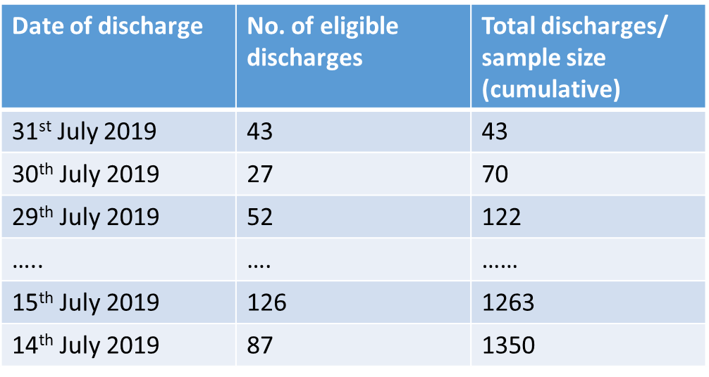
Drawing the sample
Sample should include 1250 eligible patients who stayed overnight and were consecutively discharged from 31st July 2019:
If there are <1250 eligible patients in July, trusts should sample backwards into June until they reach 1350 (then cap at 1250 after exclusions and deceased checks).

Slide 23
Drawing the sample
Enter sample data into the Sample Construction Spreadsheet.
Please follow the instructions carefully and check all inclusion and exclusion criteria to prevent sampling errors.
Full details in Sampling Instructions.

Slide 24
Common sampling errors
Including ineligible patients such as obstetric/maternity patients
Excluding patients during the sample period that do not have complete clinical coding
Excluding patients based on age
Excluding patients who have not had a procedure
Providing treatment function codes on admission and not on discharge
Missing or incorrect CCG codes or site codes
Full details available in Sampling Errors Report

Slide 25
Sample declaration form
Excel sheet with a series of checklist items.
Comment boxes for trusts to explain N/As.
Additional comment box for trusts to explain any changes in sample profile since 2018.
Must be electronically signed by the person drawing the sample and the Caldicott Guardian.

Slide 26
Sample declaration form
Email to contractor (or Survey Coordination Centre for in-house trusts) before submitting sample file.
Must be sent from email of Caldicott Guardian, or from email of sample drawer with Caldicott Guardian copied in.
Form must be approved before sample file is submitted.
Form will be published on our website following S251 approval being granted

Slide 27
Submission of sample files
Sample declaration form must be approved before any files are submitted.
Trusts using a contractor: submit a single file to your approved contractor containing both sample and mailing information to contractor’s FTP. They will provide instructions on how to do this.
In-house trusts: submit only the sample data to the Survey Coordination Centre’s FTP.
All trusts must password protect their files.
The Survey Coordination Centre must not receive any mailing data.

Slide 28
Deceased checks
It is essential that multiple deceased checks are conducted throughout the survey period.
Five stages of checks:
Initial trust (local) check prior to submitting sample
DBS check prior to submitting sample
Trust local check prior to 1st mailing
Trust local check check prior to 2nd mailing
Trust local check prior to 3rd mailing (DBS recommended)
Trusts using a contractor: advise your contractor immediately if any patients die after submitting your sample.
In-house trusts: record deaths with the appropriate outcome code in the sample file (code 3 if this was after fieldwork had started; code 7 if this was prior to your first questionnaires being mailed out).

Slide 29
Sampling and submission overview (trusts using a contractor)
Trust compiles sample of eligible patients.
Trust conducts internal and DBS checks for deaths of patients. Trust removes any deceased.
Trust submits sample declaration form to contractor. Contractor checks the form.
Once sample declaration form is approved, trust submits a single sample and mailing file to contractor’s FTP.
Contractor checks the file and responds to trust with any queries.
Contractor creates separate sample and mailing files.
Contractor submits declaration form and sample file (not mailing file) to Survey Coordination Centre.
Survey Coordination Centre checks sample and sends queries/approval to contractor.
Once sample approved by Survey Coordination Centre, contractor sends out mailing packs for trust.

Slide 30
Sampling and submission overview (in-house trusts)
Trust compiles sample of eligible patients.
Trust conducts internal and DBS checks for deaths of patients. Trust removes any deceased.
Trust creates separate sample and mailing files.
Trust submits sample declaration form to Survey Coordination Centre. Survey Coordination Centre checks the form.
Once sample declaration form is approved, trust submits sample file only to Survey Coordination Centre’s FTP.
Survey Coordination Centre checks sample and sends queries/approval to trust.
Once sample approved by Survey Coordination Centre, trust sends out mailing packs.

Slide 31
Sample submission deadlines
Sample checking dates (Survey Coordination Centre): 12th - 30th August
Survey Coordination Centre (SCC) submission deadline: 23rd August
Escalation strategy for late trusts:
Contact by SCC: 2nd September
Contact by CQC: 6th September
Contact by CQC inspector: 13th September
Details included in sampling instructions

Slide 32
Tips for entering fieldwork on time
Entering fieldwork on time or early will help your trust to maximise your response rate, especially from younger patients and minority ethnic groups.
Ensure you have a survey team in place before you start drawing your sample.
Generate your sample promptly – begin preparing now.
Respond to queries as soon as possible to avoid unnecessary delays.
Ensure there is sufficient resourcing around the sample drawing period – communicate with your team, and hand over tasks if staff are going to be on leave.

Slide 33
Fieldwork monitoring information

Slide 34
Fieldwork monitoring information (in-house trusts only)
Due every Thursday from 5th September
Template will be provided on website.

Slide 35
Key dates

Slide 36
Key dates
Release of sampling materials | July 2019 (following s251 approval)
Survey materials (questionnaire and covering letters) | July 2019 (following ethical approval)
Sample checking | 12th- 30th August
PDFs and hard copies of questionnaires and letters submitted (in-house trusts only) | Early August
Fieldwork | 27th August - 3rd January 2020
Scanned respondent questionnaires submitted (in-house trusts only) | Soon after start of fieldwork
Weekly monitoring (in-house trusts only) | Every Thursday during fieldwork, starting 5th September
Deadline for final data (in-house trusts only) | 10th January 2020

Slide 37
Thank you for your time
A copy of these slides will be available on the NHS Surveys website (http://nhssurveys.org/surveys/1433)
Survey Coordination Centre contact details:
inpatient@surveycoordination.com
01865 208 127

